Slide 1

Automatic Washing Machine Controller
Digital System desing lab
Project by
Muhammad Umar jan 21pwcse2000
Muhammad Saad 21pwcse1997
Aiman Maab 21pwcse2076

Slide 2
1. Introduction
Objective: To design a finite state machine (FSM) for an automatic washing machine using Verilog.
Functionality: Control the washing machine through various states based on inputs such as door status, start command, water fill status, detergent addition, and cycle completions.

Slide 3
2. Inputs and Outputs
INPUTS
clk: Clock signal
reset: Reset signal
door_close: Indicates if the door is closed
start: Start signal for the washing machine
filled: Indicates if the water is filled
detergent_added: Indicates if the detergent has been added
cycle_timeout: Indicates that the wash cycle is complete
drained: Indicates if the water is drained
spin_timeout: Indicates that the spin cycle is complete

Slide 4
2. Inputs and Outputs(Continue)
OUTPUTS
door_lock: Controls the door lock
motor_on: Controls the motor
fill_value_on: Controls the water filling valve
drain_value_on: Controls the drain valve
done: Indicates the washing is complete
soap_wash: Indicates if the soap wash is active
water_wash: Indicates if the water wash is active

Slide 5
3. States
check_door (000): Check if the door is closed and start button is pressed.
fill_water (001): Fill the washing machine with water.
add_detergent (010): Add detergent to the washing machine.
cycle (011): Perform the wash cycle.
drain_water (100): Drain water from the washing machine.
spin (101): Perform the spin cycle.
.

Slide 6
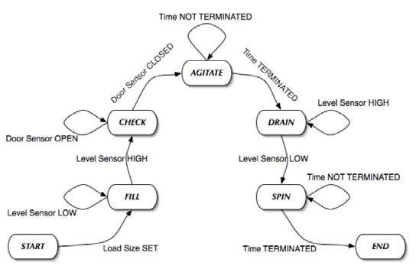
4. State Transition Diagram

Slide 7
5. State logic and output logic
----------------
----------------
----------------
----------------
----------------
----------------

Slide 8
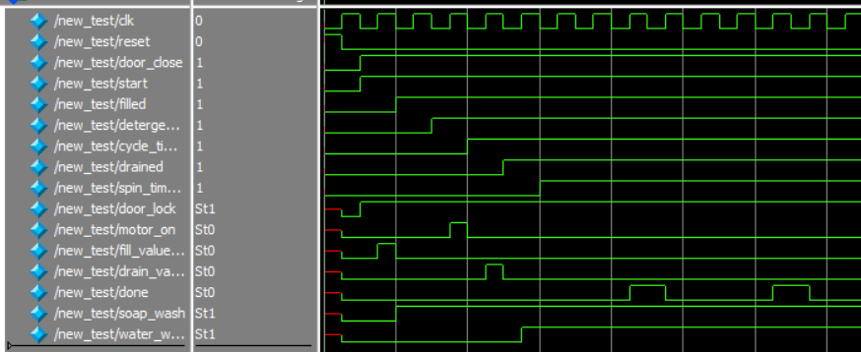
6. Simulation and Testing
ModelSim and XILINX ISE are used for testing, simulation and synthesis

Slide 9
7. Conclusion
This project offers a valuable opportunity to explore and implement a Finite State Machine in a practical application. The resulting washing machine control system will demonstrate the benefits of FSMs in managing complex systems and provide a user-friendly experience for operating a washing machine.

